Slide 1
Arcology
Nicholas Simos and Owen Stallings

Slide 2
Overview
History
Implementation
Pros
Cons

Slide 3
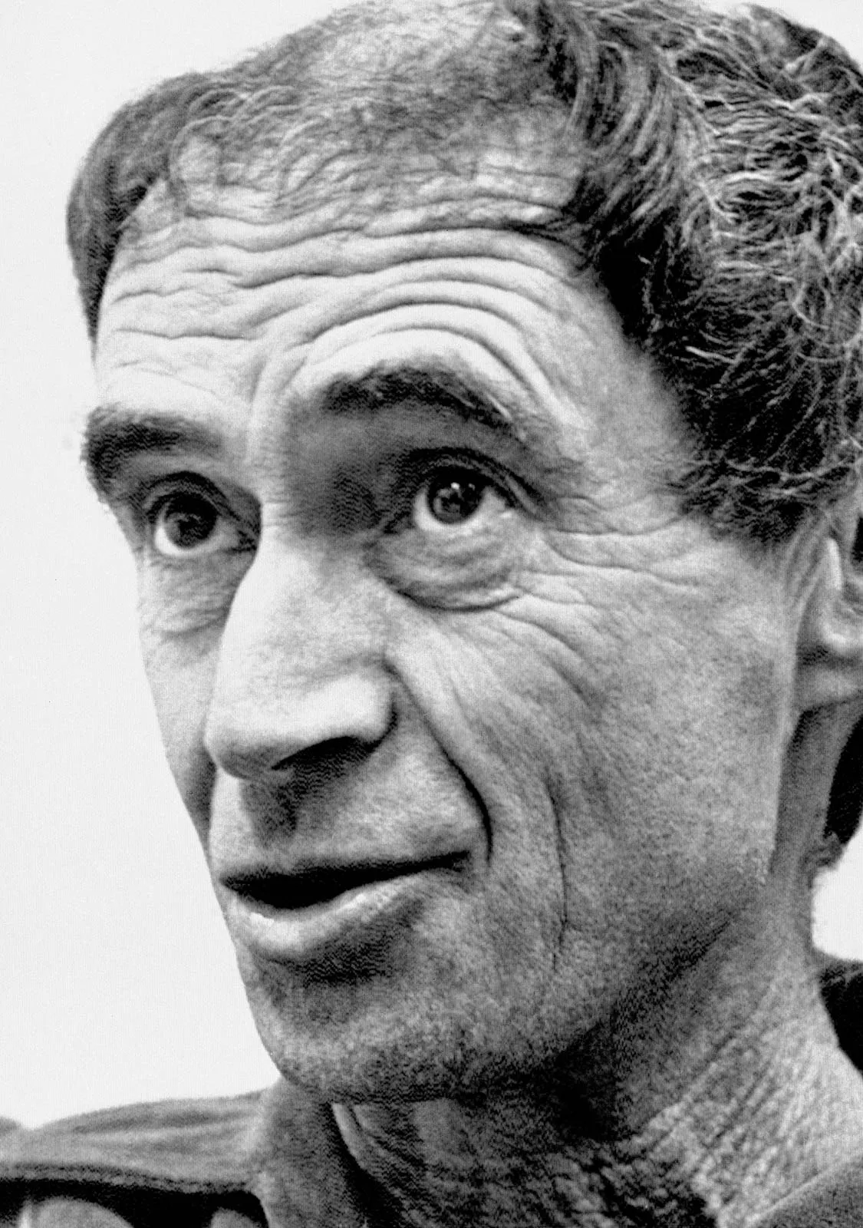
History
The term was coined in 1969 by architect Paolo Soleri
The concept was created to be a mix of residential, agricultural, and commercial facilities in which humans would have little environmental impact.
Notes:
The term was coined in 1969 by architect Paolo Soleri, who believed that a completed arcology would provide space for a variety of residential, commercial, and agricultural facilities while minimizing individual human environmental impact.

Slide 4
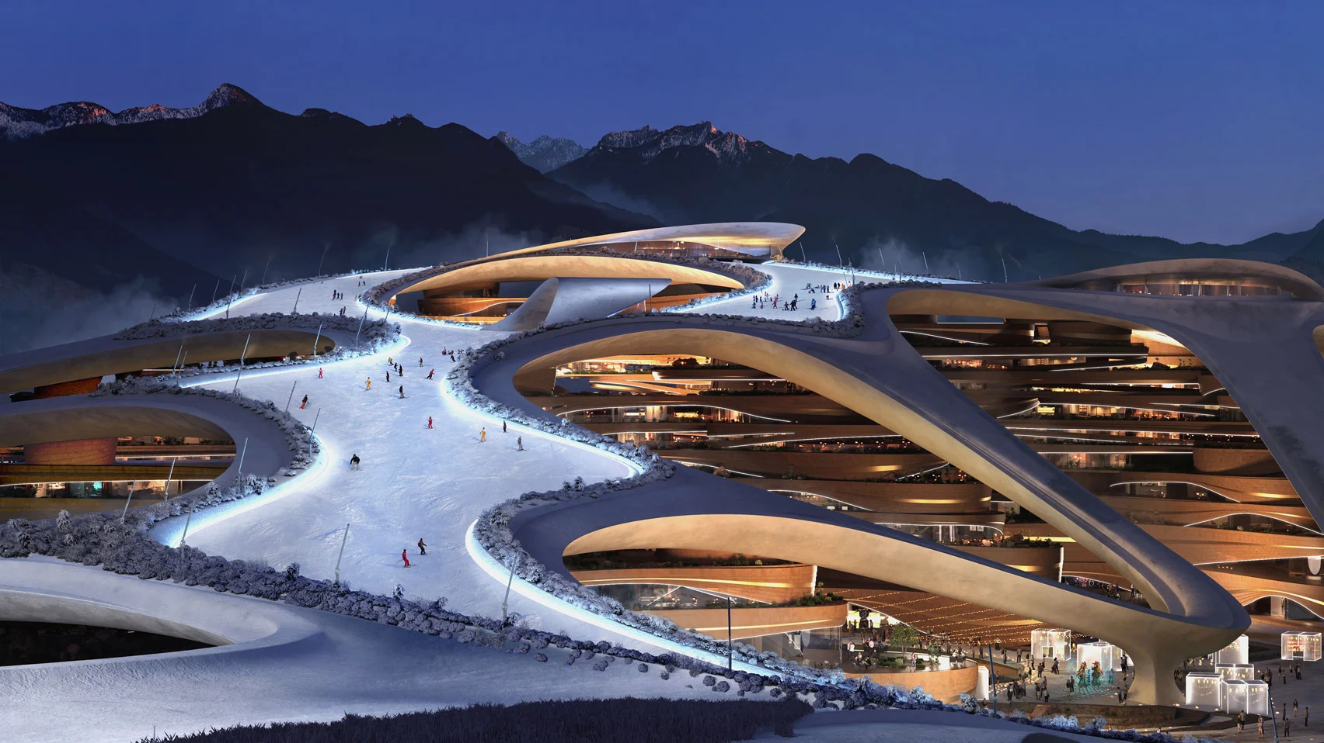
Implementation
Real world implementation of arcology is not as far away as it may seem and places like Saudi Arabia are at the forefront of this new architecture with their 4 futuristic cities. Some of these cities are not even 20 years away from completion.
Neom Resort
Notes:
The implementation does not come cheap for these structures as this resort is going to cost 500 B to make and countless more for maintenance.

Slide 5
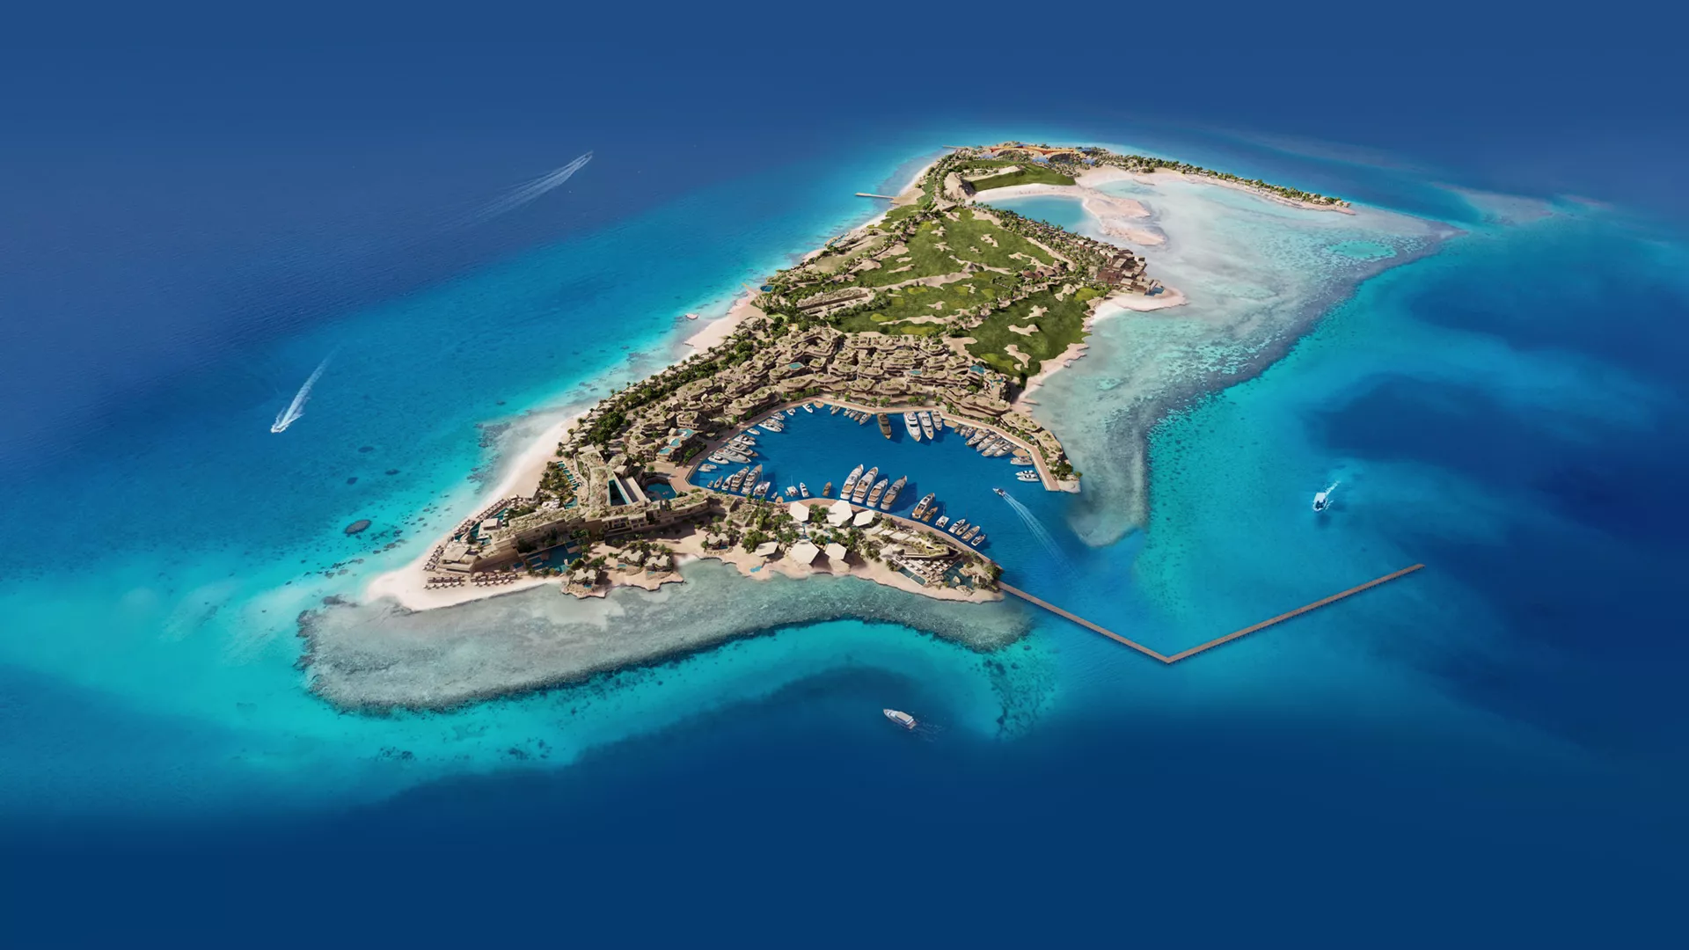
Implementation
The plan for implementation of these things is usually to phase permanent residents into living there and use the rest for tourism.
Trojena

Slide 6
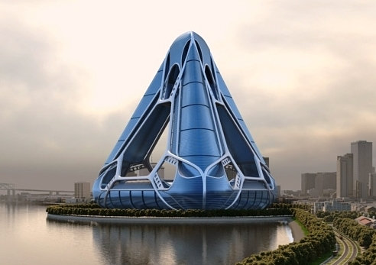
Pros
Arcology structures can create carbon neutral economies because it would eliminate need for transportations like cars that release carbon .
They would be able to find a better and cleaner way to use resources efficiently.
They would be able to easily make wind turbines, water recovery, gardens, and more.
Notes:
The structure is designed to expand the horizon of sustainability and will seek LEED certification.
It will eliminate the need for cars within the urban structure, and thus becomes a carbon neutral entity. Internal electric transport links, vertical and horizontal, create a pedestrian-friendly community,
Some of these elements are secured wind turbines, fresh water recovery and storage systems, passive glazing system, sky garden heating/cooling vents, grey water treatment, solar array banding panels, and river based water turbines.
you will join world-leading talents; a global community of visionary minds and adventurous spirits, brought together by the chance to make history.
No roads, cars or emissions, it will run on 100% renewable energy and 95% of land will be preserved for nature. People's health and wellbeing will be prioritized over transportation and infrastructure, unlike traditional cities.

Slide 7
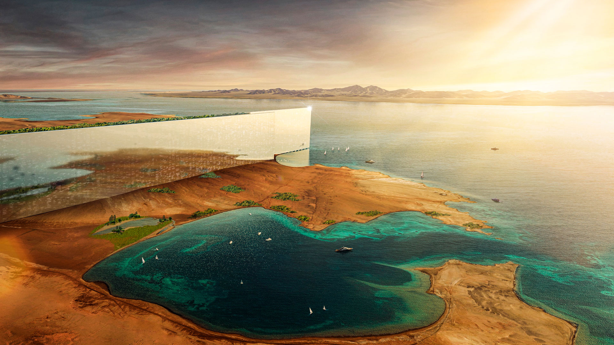
Pros
There would be more job opportunities us innovate and create these new eco-cities
95% of nature outside of these cities will be preserved.
The health of the community inside thes eco-cities will prioritised over infrastructure.

Slide 8
Summary
We are for this technology because it will help slow global warming and make our planet more enjoyable to live on by offering crazy experiences. It is also a positive to the planet because of the hugh step architecture has to take in order to make these structures.

Slide 9
Cons
Would take a huge feat of engineering to build most of the cities.
The cost would be huge and might not be worth it.

Slide 10
Cons
It could lead to a crowded skyline and might become a tourist attraction that only the rich can afford
It might be an inefficient transition from normal cities to Arcology cities which could be bad for the economy

Slide 11
https://www.yankodesign.com/2009/08/17/heavenly-abode/
https://keep.lib.asu.edu/items/133644

